Slide 1

KINEMATICS
FISIKA DASAR 1

Slide 2
Kinematics: Description of Motion
Relative Velocity
Multi-body Kinematics Problems
Overview
Adopted from MIT Course

Slide 3

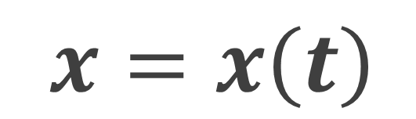
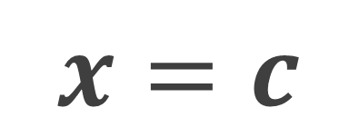
Description of Motion
Introduction
$$x=x\left(t\right)$$
$$x=c$$
All measurements require an origin, a coordinate system, and units
Next complication is “reference frame”, the term used to describe the motion of observer
Constant velocity is OK, accelerated observer is not
Basic definitions:
Position
Distance versus displacement
Exclusive Material
Bring your business to the next Level with Powerfull presentation material for all business
Velocity - change of position
Speed is the magnitude of velocity
Acceleration - change of velocity
Adopted from MIT Course

Slide 4
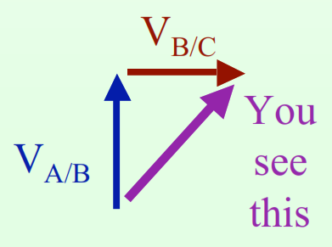
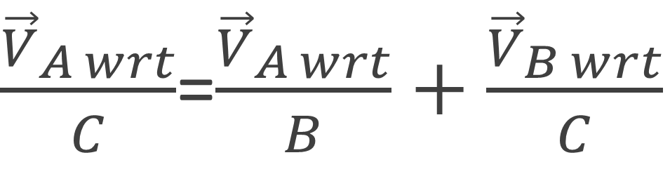
Relative Velocity
Kinematic
Basic Concept
Notation: use “wrt” to indicate “with respect to”
Observer B sees a moving object A, and
Observer B is moving relative to observer C, so
What does observer C see for the motion of the object?
$\frac{{\vec{V}}_{A wrt}}{C}$=$\frac{{\vec{V}}_{A wrt}}{B}+\frac{{\vec{V}}_{B wrt}}{C}$
Example: A=ball, B=me, C=you
Adopted from MIT Course

Slide 5
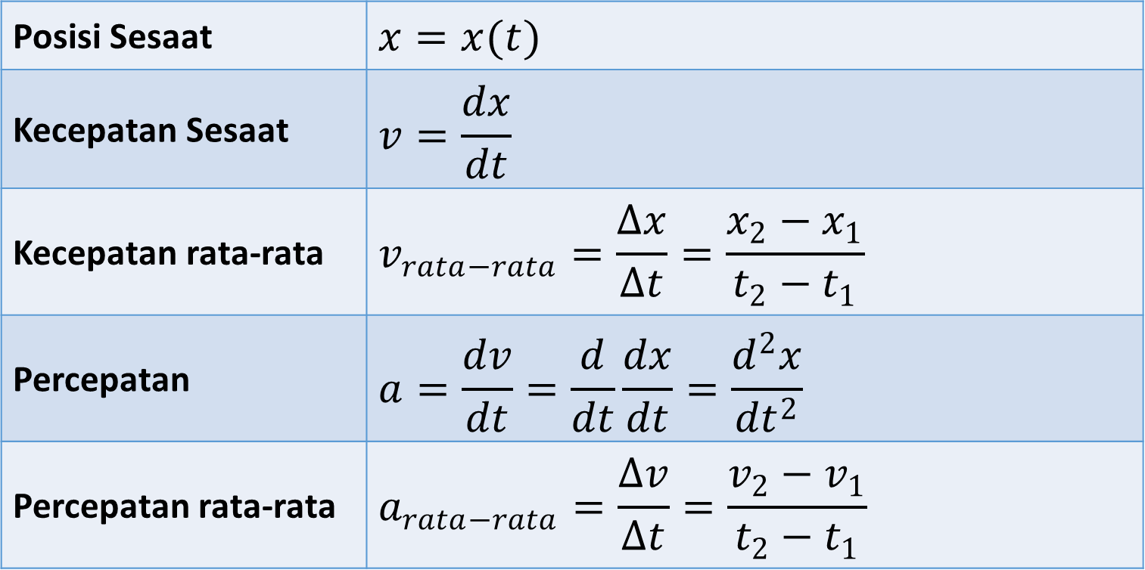
Fisika 1
Kinematics Concepts
Posisi Sesaat | $$x=x(t)$$
Kecepatan Sesaat | $$v=\frac{dx}{dt}$$
Kecepatan rata-rata | $$v_{rata−rata}=\frac{Δx}{Δt}=\frac{x_{2}−x_{1}}{t_{2}−t_{1}}$$
Percepatan | $$a=\frac{dv}{dt}=\frac{d}{dt}\frac{dx}{dt}=\frac{d^{2}x}{{dt}^{2}}$$
Percepatan rata-rata | $$a_{rata−rata}=\frac{Δv}{Δt}=\frac{v_{2}−v_{1}}{t_{2}−t_{1}}$$

Slide 6
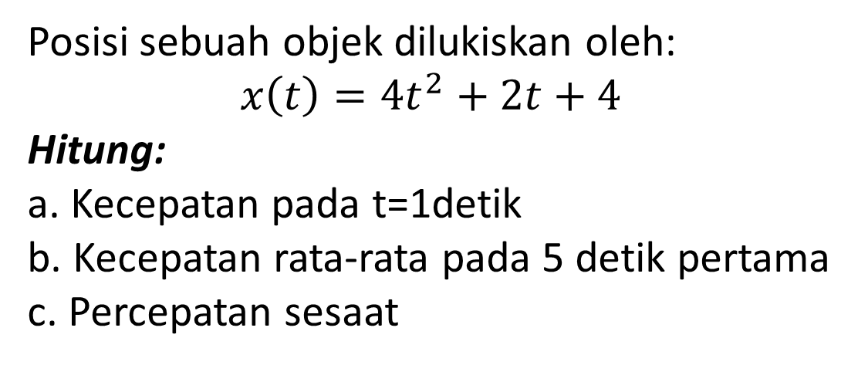
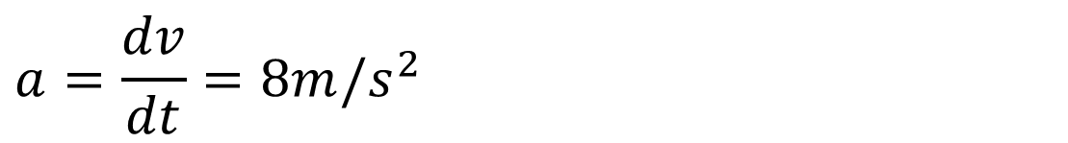
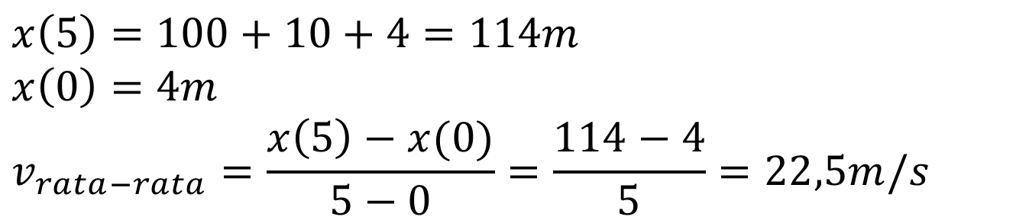
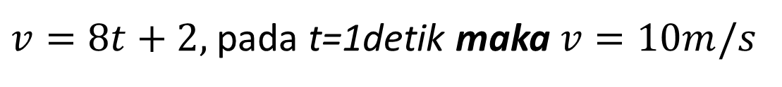
Example
Example
Posisi sebuah objek dilukiskan oleh:
$$x\left(t\right)=4t^{2}+2t+4$$
Hitung:
a. Kecepatan pada t=1detik
b. Kecepatan rata-rata pada 5 detik pertama
c. Percepatan sesaat
Answer:
a.
$v=8t+2,$pada t=1detik maka $v=10m/s$
b.
$$x\left(5\right)=100+10+4=114m$$
$$x\left(0\right)=4m$$
$$v_{rata−rata}=\frac{x\left(5\right)−x(0)}{5−0}=\frac{114−4}{5}=22,5m/s$$
$$a=\frac{dv}{dt}=8m/s^{2}$$
c.

Slide 7
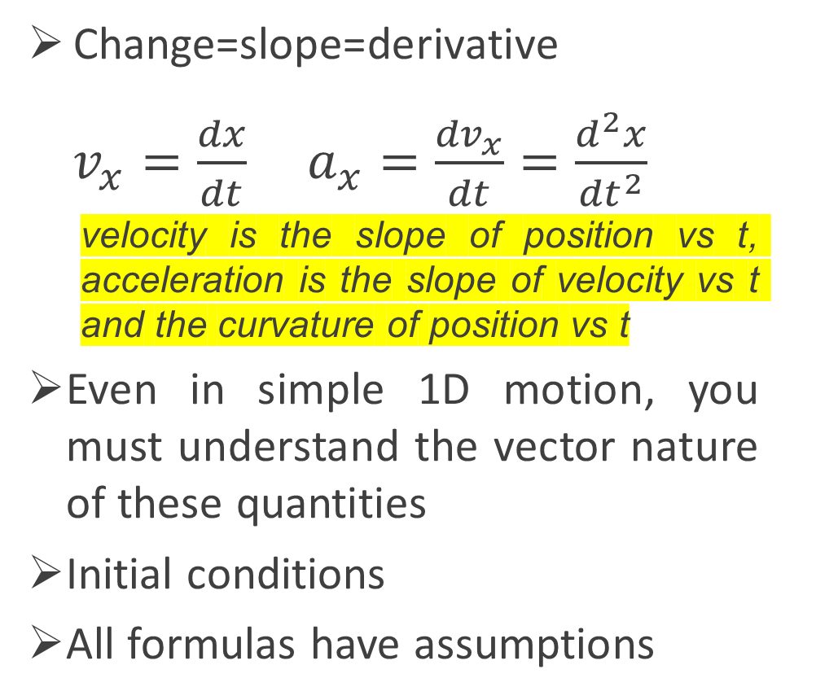
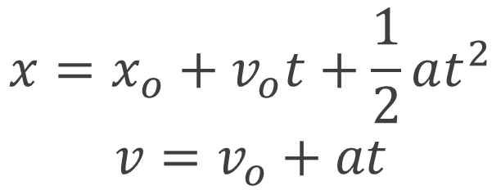

Key Kinematics Concepts
One Important Special Case
Change=slope=derivative
$v_{x}=\frac{dx}{dt}$ $a_{x}=\frac{{dv}_{x}}{dt}=\frac{d^{2}x}{{dt}^{2}}$
velocity is the slope of position vs t, acceleration is the slope of velocity vs t and the curvature of position vs t
Even in simple 1D motion, you must understand the vector nature of these quantities
Initial conditions
All formulas have assumptions
Constant Acceleration =$a$
$$x=x_{o}+v_{o}t+\frac{1}{2}at^{2}$$
$$v=v_{o}+at$$
Initial conditions
Physics
Adopted from MIT Course

Slide 8
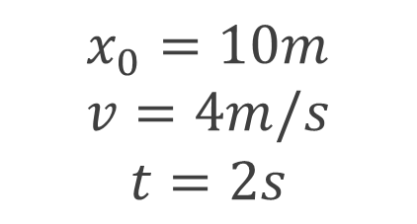
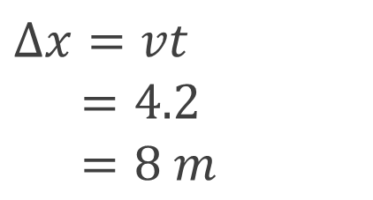
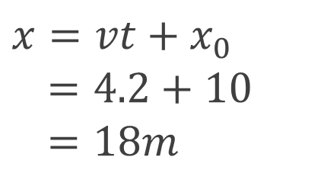
Example 1
Example
A car is moving straight at a constant velocity of 4m/s. The starting position is 10m to the reference, then the car runs for 2 seconds. Calculate:
Current car position
Distance
Answer:
a.
$$Δx=vt$$
$$=4.2$$
$=8 m$
$$x_{0}=10m$$
$$v=4m/s$$
$$t=2s$$
$$x=vt+x_{0}$$
$$=4.2+10$$
$=18m$
b.

Slide 9
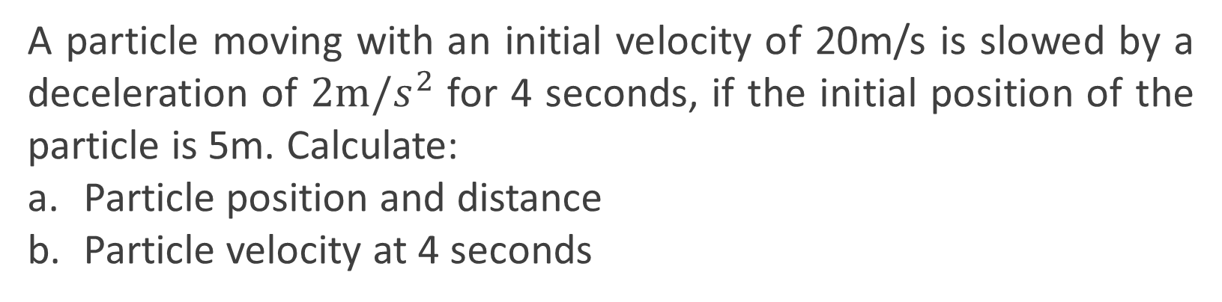

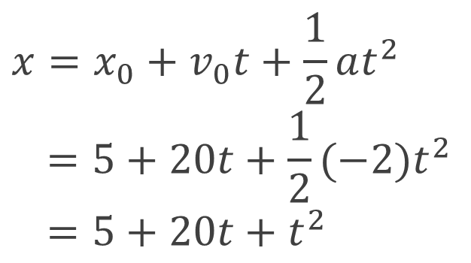
Example 2
Example
A particle moving with an initial velocity of 20m/s is slowed by a deceleration of $2m/s^{2}$ for 4 seconds, if the initial position of the particle is 5m. Calculate:
Particle position and distance
Particle velocity at 4 seconds
Answer:
$$x=x_{0}+v_{0}t+\frac{1}{2}at^{2}$$
$$=5+20t+\frac{1}{2}(−2)t^{2}$$
$$=5+20t+t^{2}$$
$$v=v_{0}+at$$
$$=20+\left(−2\right)4$$
$=12m/s$
a.
b.
Exclusive Material
Bring your business to the next Level with Powerfull presentation material for all business
$$x\left(4\right)=5+20\left(4\right)+{\left(4\right)}^{2}=69m$$
$$Δx=x−x_{0}=69−5=64m$$

Slide 10
Vector
Multi-body Kinematics Problems
Need to use consistent coordinate system and origin for all objects
Need to think carefully about directions (signs!)
Need to think carefully about initial conditions, especially when things “start” at different times
Write separate equations for each object
Read problem carefully to understand the
specific constraint to use to solve
Adopted from MIT Course

Slide 11

SUMMARY
Kinematics provides a language to describe motion
Basic relationship between position, velocity, acceleration (change=slope=derivative)
Study special cases (like constant acceleration) but understand the assumptions that go into all Formulas
Position, velocity, and acceleration are ALL vectors and need to be manipulated using either arrows (qualitative) or components (quantitative)
Directions (or signs in 1D) of position, velocity, and acceleration can all be different
Adopted from MIT Course

Slide 12
THANK YOU

